Slide 1
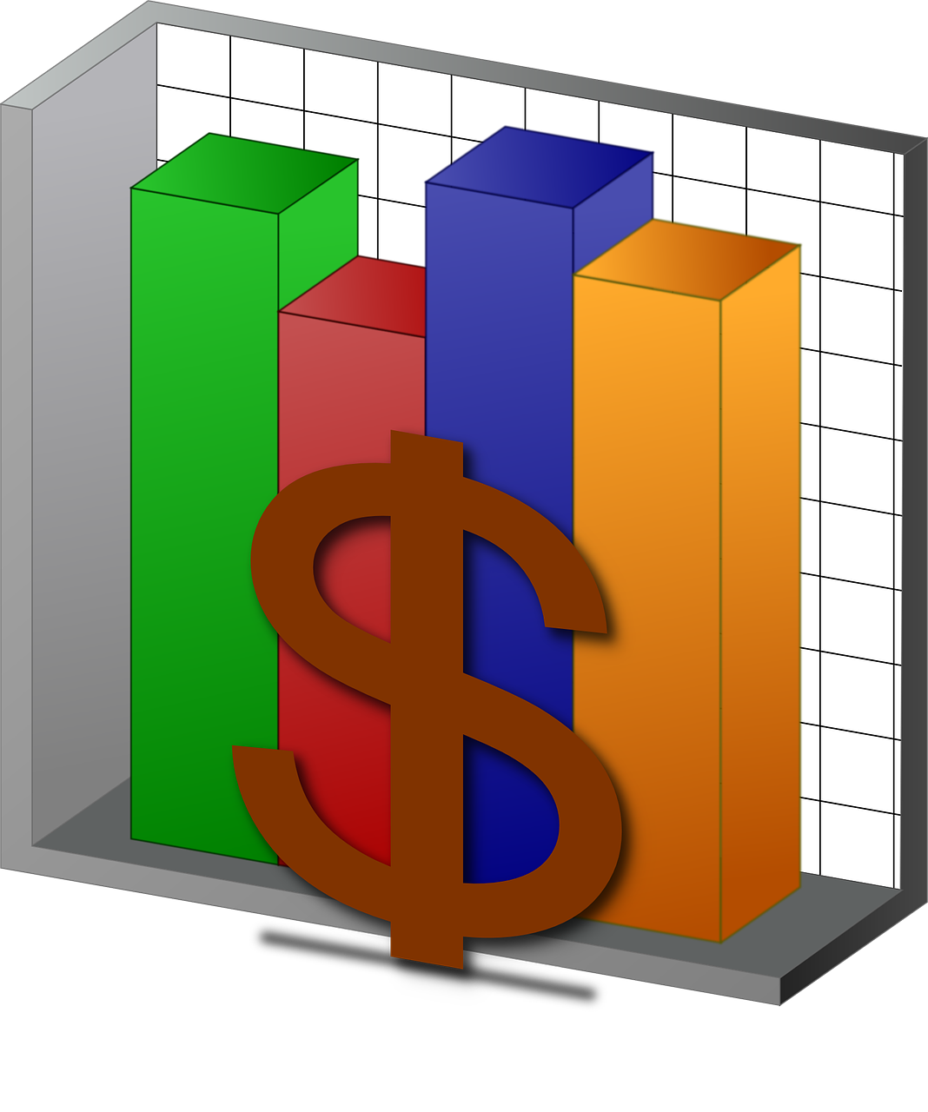
Budget Tracker
Team G: K Atta-Boakye, J Park, A Shoaib

Slide 2
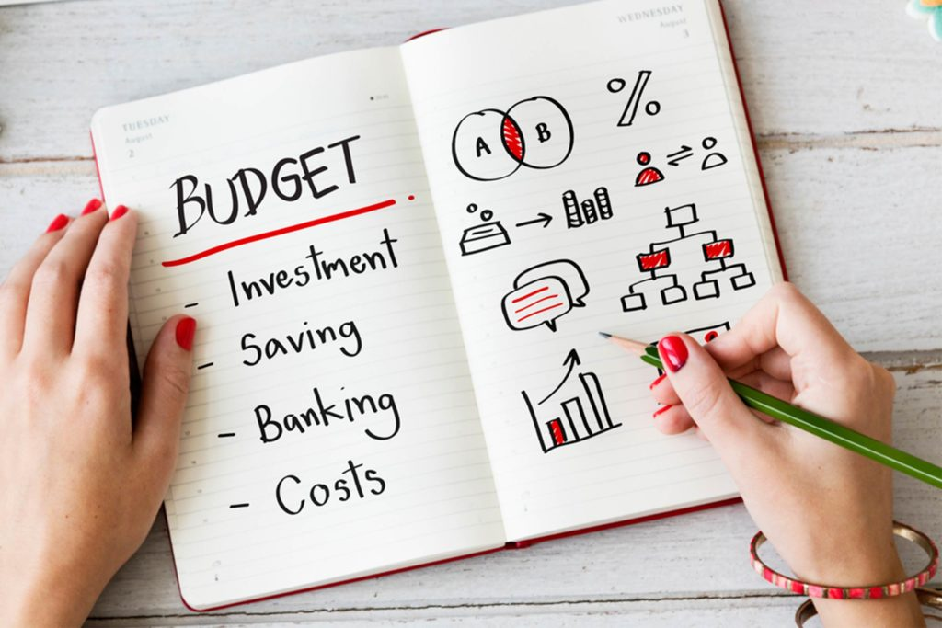
Objective statement
We are creating an expense tracker where users can keep track of how they are spending their monthly income. The main goal is to have set goals for spending monthly that we can monitor. We will keep track of spending on a month to month basis which will help adjust monthly spending goals. We wanted to do this as a group because as young adults, keeping track of where our money is going is essential. We want to have fun but at the same time make sure we have enough for important expenses. People may use excel to do all these expense tracking, but our software will generate the graphs as data is given and help users adjust their expense plans.

Slide 3
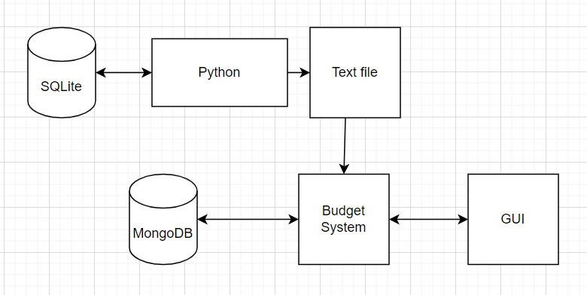
Initial Design Approach
C++
Initially, the project was going to be built on the C++ language and libraries through qt creator, since we knew we wanted the end product to have an interactive GUI
WireShark
The purpose of this was to keep track of the users’ URL visits
MongoDB
To as work as the database to store the user and their purchase information

Slide 4
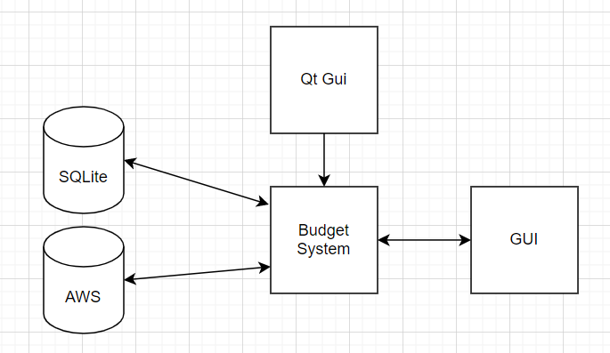
Final Design Approach
Python
After finding many difficulties with cpp, we saw that python had many helpful libraries that made connections to the database easier to manage.
Qt Widget implementation became a lot more difficult without the drag/drop Ui.
The UI was still kept from cpp and imported into the python code
AWS database
This was switched from MongoDB
Preference was to have a relational database, as the tables are all joined by customer ID and this would make querying more simple
Can utilize SQL
SQLite database
This database is used to store all the links in the browser. This helps extract the domain names for the websites.

Slide 5
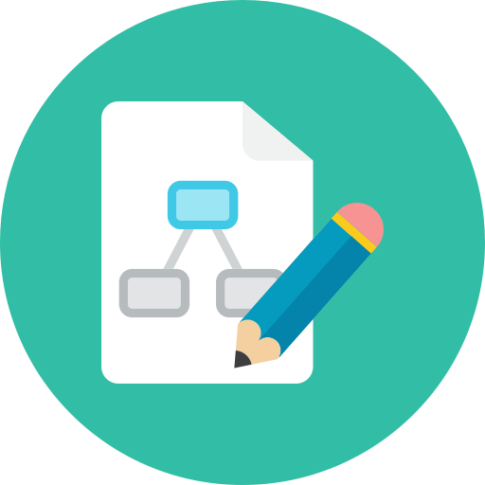
Sprint progress
Sprint 1
Obtaining basic user information
Storing user data
Creating simple graphs
Sprint 2
GUI prototype development
Track user subscriptions
Fluid Graphs
Sprint 3
Sending user information to database
Database to GUI
Language conversion

Slide 6

Demo

